Slide 1
Basic Internship@Clevered Sentiment Analyzer
App User Manual
Author: Mayur Narayan T K

Slide 2
Table of Contents
1)Acknowledgements
2)About me
3)ABout my Interns

Slide 3
Acknowledgements
A small vote of thanks for all who have helped you in this journey of App Development – your parents, Mr Ken, Clevered, Mentors, Group Members, Friends, Sites etc.

Slide 4
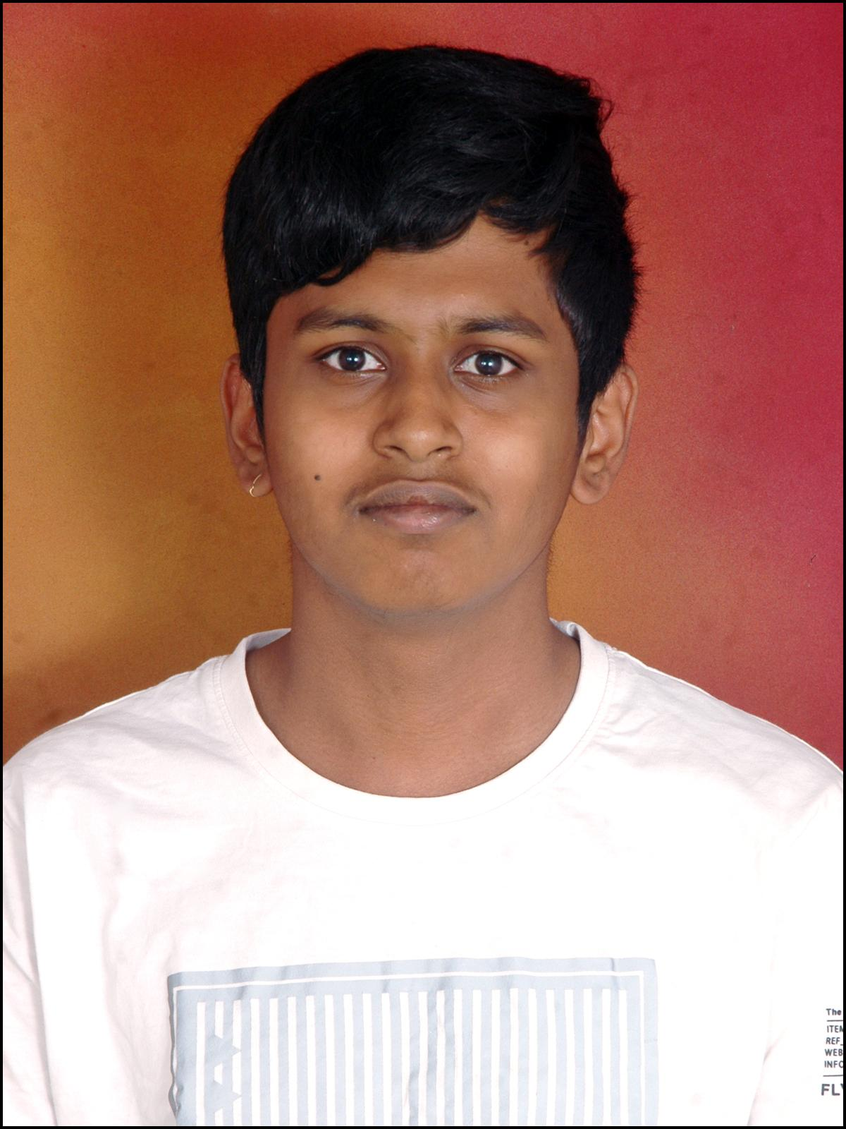
About Me..
Name: Mayur Narayan T K
Class: 12 ISC
School: Mallya Aditi
Age: 17
Residence: Banglore, Karnataka India.
I'm Mayur, and I've been captivated by the limitless possibilities of technology since 6th-grade computer classes. AI, Python, and Java are my passions—tools that allow me to create, innovate, and shape unique digital experiences. Computers have been my portal to knowledge and the impetus for creating something unique. The adventure continues, propelled by the thrill of coding and the ever-expanding landscape of technological exploration.

Slide 5
About My Internship with Clevered..
During my internship at CleverEd, I gained invaluable insights into educational technology and innovation. Collaborating with a dynamic team, I contributed to developing user-friendly interfaces and enhancing the functionality of educational platforms. Through hands-on projects, I honed my programming skills and learned to adapt swiftly to evolving industry trends. The supportive environment fostered my creativity and problem-solving abilities. Regular feedback sessions and mentorship further enriched my professional growth. Overall, my internship at CleverEd was a transformative experience, providing me with practical skills and a deeper understanding of the intersection between technology and education.
Some Badges Earned
Rockstar For Attentiveness
Rockstar for Project Completion

Slide 6

About App..
Emosense is an Ap that uses AI to recognize the emotion of the user when they record the audio.
It was built using IDLE and Python.
Some libraries used
Speech_recognition
nltk
SentimentIntensityAnalyzer

Slide 7
How do I use the App?
The app includes a "Record Voice" button for easy audio capture. There is also a stop button that allows the user to stop the recording whenever they want. By doing this the users can record their voice effortlessly. Post-recording, the AI utilizes advanced algorithms to analyze emotional nuances in the audio, providing users with a precise emotional assessment. The response is displayed in the Response box under the stop button. This will allow the user to see the assessment directly. If the user to wish to check another sentence, they need not run the program one more time. They just need to click the record button to start the program again.

Slide 8
EMOSENSE
Screenshot/ Pic of each option/screen of the App
REQUIREMENTS
The microphone should be clear and working properly.
The wifi must be fairly good to run it with ease
After pressing the record audio button speak slowly clearly and a bit loudly, this will make it easier for the AI to to capture so it can give you an accurate answer.

Slide 9
Contact Person
Please reach out to Mayur Narayan T K at mayurnarayan23@gmail.com for any questions/ concerns/ suggestions on the App

Slide 10
Thank you!

